Slide 1
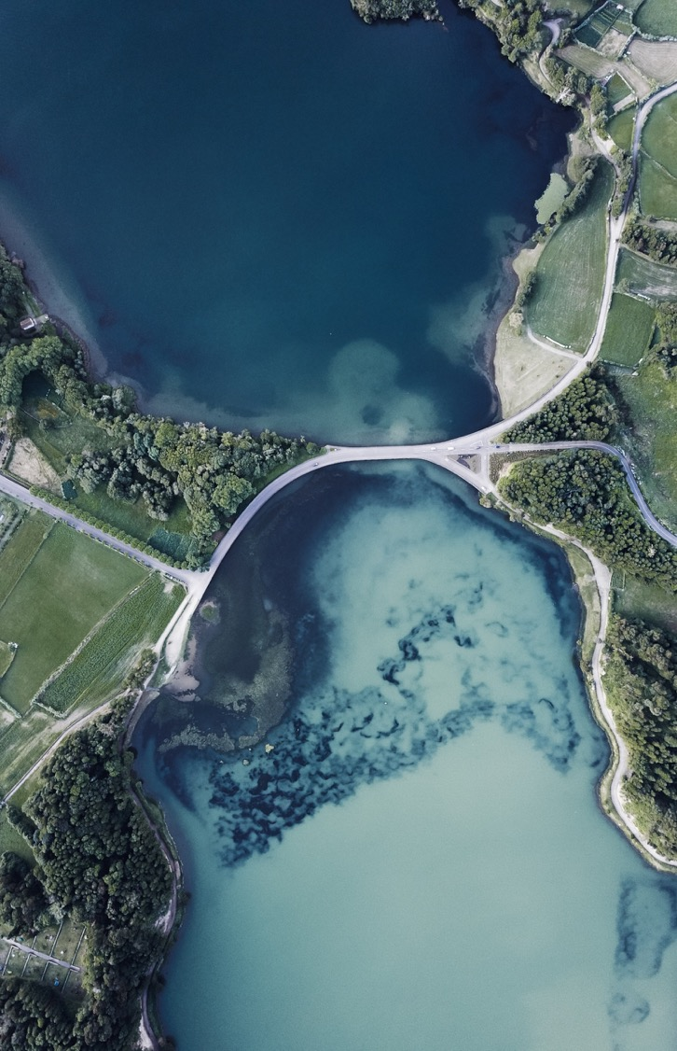
DETECTION AND PREDICTION OF LAND changes USING DEEP LEARNING
TEAM MEMBERS
S.AJAY KUMAR (2015506003)
K.REVATHY (2015506090)
T.DIVYA SHREE (2015506013)
BATCH 15
GUIDE: Ms. S. ELIZA FEMI SHERLEY

Slide 2
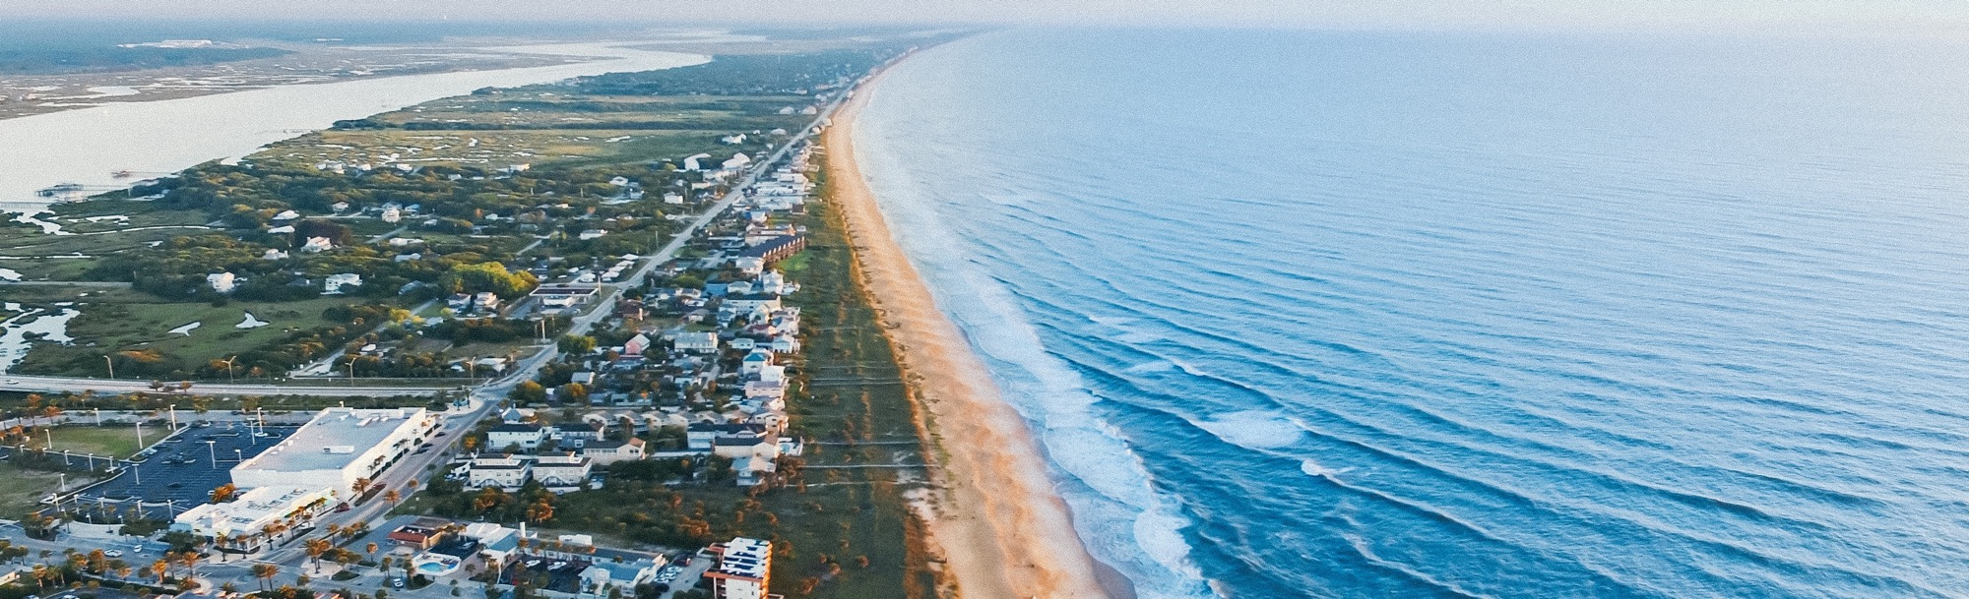
OBJECTIVE
To analyze the Land Use and Land Cover (LULC) changes from multi spectral images collected over a specific period of time using object based deep learning techniques, and predict the changes in the near future in a particular geographic location.

Slide 3
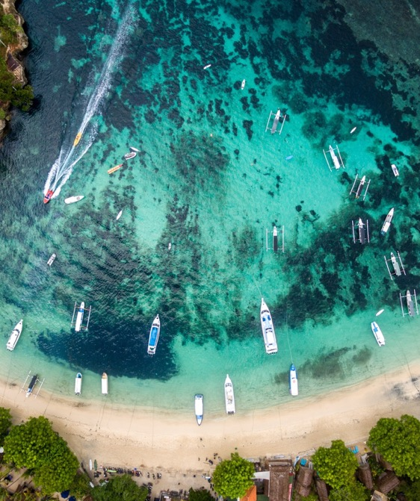
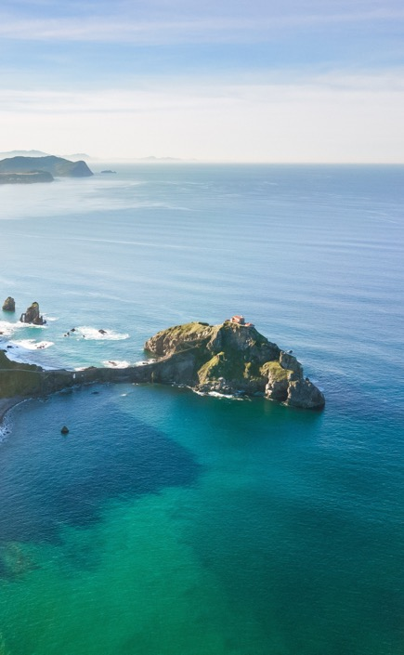
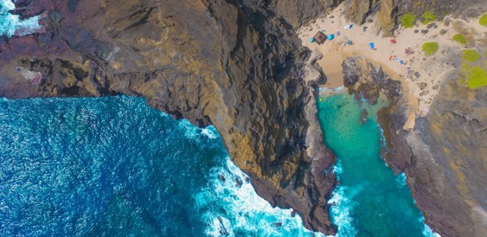
PROBLEM STATEMENT
To classify the different Land use and Land cover classes using multispectral images collected over a period of time by using object based deep learning classification techniques and analyse the changes in the Land use Land cover classes to predict the changes in the near future.

Slide 4
Literature survey #1
Wenzhi Zhao et al “Object-Based Convolutional Neural Network for High-Resolution Imagery Classification” (2017)
OBJECTIVE:
This Study is about object-based deep learning method to accurately classify the high-resolution imagery without intensive human involvement.
METHODOLOGY:
High-level feature representations extracted through the convolutional neural networks framework have been systematically . To improve the classification accuracy, an object based classification method also has been integrated with the deep learning strategy for more efficient image classification.
DATASET:
The datasets analyzed include three very different cities with complex urban conditions:
Beijing
Pavia
Vaihingen.
CONCLUSION:
The combination of object-based image interpretation and deep learning method provides accurate target’s boundary information as well as semantic labels.

Slide 5
Literature survey #2
Ce Zhang et al “An object-based convolutional neural network (OCNN) for urban land use classification” (2018)
OBJECTIVE:
This study is about extraction of urban land use from very fine spatial resolution (VFSR) remotely
sensed imagery using Convolution Neural Network.
METHODOLOGY:
object-based segmentation was initially employed to characterise the urban landscape into functional units,
which consist of two geometrically different objects, namely linearly shaped objects (e.g. Highway, Railway, Canal) and other (non-linearly shaped) general objects. Two CNN models with different Structures were used for urban land use classification.
DATASETS:
Landsat-8 OLI–TIRS
CONCLUSION:
Classifying urban land use requires not only a precise characterisation of image objects as functional
units, but also an accurate and robust representation of spatial context.

Slide 6
LITERATURE SURVEY #3
Fotso Kamga Guy et al. “A deep heterogeneous feature fusion approach for automatic land-use classification”
OBJECTIVE:
In this paper a novel hybrid system for satellite image classification that combines the distinct information of deep features, and generate a discriminative representation by preserving the essential information of original feature space is proposed.
METHODOLOGY:
Pre-trained convolutional neural networks are used for extracting our features via transfer learning. CNN fully connected layers are effectively used to represent different levels of image features. Then the entropy controlled neighbourhood component analysis, is then proposed to optimize fusion of multiple layers of different architectures .
DATASET:
UC MERCED
RS19
AID
CONCLUSION
Fusion of features from multiple layers mostly produces better results compared to extracted features from a single layer. An improved selection criteria, produces significant classification results.

Slide 7
Literature survey #4
Nataliia Kussul et al. “Deep Learning Classification of Land Cover and Crop Types Using Remote Sensing Data”
OBJECTIVE:
This paper describes a multilevel DL architecture that targets land cover and crop type classification from multitemporal multisource satellite imagery
METHODOLOGY:
Unsupervised neural network (NN) and an ensemble of supervised NNs are used for optical imagery segmentation and missing data restoration . A traditional fully connected multilayer perceptron (MLP) and the most commonly used approach in RS community random forest are compared with convolutional NNs (CNNs) in the architecture.
DATASET
Nineteen multitemporal scenes acquired by Landsat-8
Sentinel-1A RS satellites.
CONCLUSION
The 2-D CNNs outperformed the 1-D CNNs, but some small objects in the final classification map provided by 2-D CNNs were smoothed and misclassified.

Slide 8
Literature survey #5
Grant J. Scott et al. “Training Deep Convolutional Neural Networks for Land–Cover Classification of High-Resolution Imagery “
OBJECTIVE:
This paper investigates the use of DCNN for land–cover classification in high-resolution remote sensing imagery.
METHODOLOGY:
From the multispectral image features are extracted with the help of CNN and Transfer learning has been used .Two techniques are employed in conjunction with DCNN: transfer learning (TL) with fine-tuning and data augmentation tailored specifically for remote sensing imagery.
DATASETS:
UC Merced data set
CONCLUSION
CNN with Fine-tuning of the Feature Extraction phase improved the classification accuracies for both the original and augmented data sets.

Slide 9
Literature survey #6
Atharva Sharma. “Land cover classification from multi-temporal, multi-spectral remotely sensed imagery using patch-based recurrent neural networks”
OBJECTIVE:
This paper proposes a new patch-based recurrent neural network (PB-RNN) system for classifying multi-temporal, multi-spectral remote sensing data.
METHODOLOGY:
The system is designed by incorporating distinctive characteristics of multi-temporal remote sensing data and and utilizing multi-spectral, multi-temporal and spatial information in remote sensing images and considering the inherit spatial and sequential interdependence among neighbouring pixels.
DATASETS:
LANDSAT-8 dataset
CONCLUSION
Classification accuracy could improve further by creating hierarchical structure classification on the top of the proposed system using different sizes of patches for the same center pixel. CNN can be incorporated with this PB-RNN system to improve the performance

Slide 10
ARCHITECTURE
MULTISPECTRAL IMAGES
PREPROCESSING
1.LAYER STACKING
2.ENHANCEMENT
Pre-processed Image
OBJECT BASED CLASSIFICATION
Spectral features
Segmented
V Objects
LAND COVER AND LAND USE MAP
FEATURE EXTRACTION
UNSUPERVISED SEGMENTATION
Land cover Map
Change Detection Map
LAND COVER AND LAND USE CHANGE ANALYSIS
PREDICTION OF LAND CHANGES USING LSTM
MSR data
Enhanced image
Segmented image
Features
Classified image

Slide 11
DATASET
Resourcesat LISS III
Advanced Remote Sensing Satellite Built by Indian Space Research Organization
Multispectral images with 4 bands collected from Bhuvan website

Slide 12
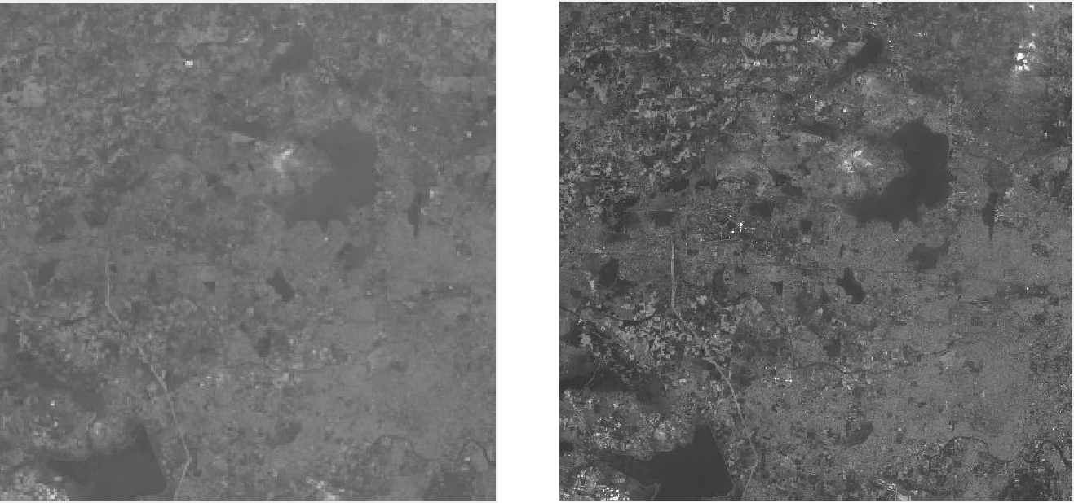
Input Images - Band 1 (Red)
Band 2 (Green)

Slide 13
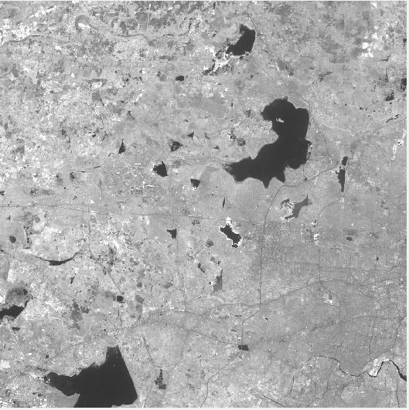
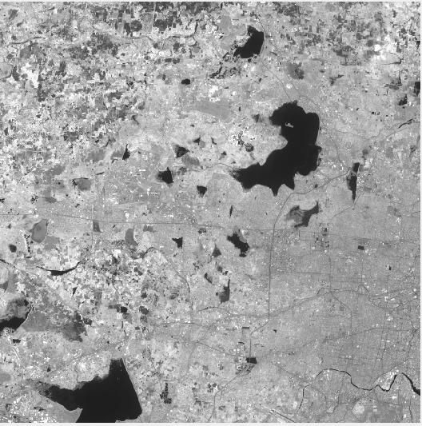
Band 3 (Near Infrared)
Band 4 (Short wave Infrared)

Slide 14
Modules
PRE - PROCESSING
Preprocessing is done to Enhance the Satellite images for us to be able to easily extract the features. We used radiometric and geometric corrections as the primary preprocessing methods.
LAYER STACKING
Layer stacking is done by placing the different band images one over the other so that we could obtain the pixel information for each and every band to make it easier for clustering.

Slide 15
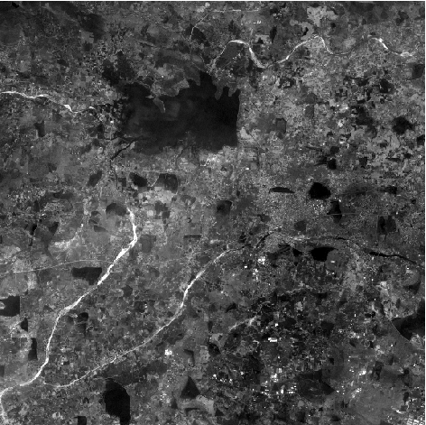
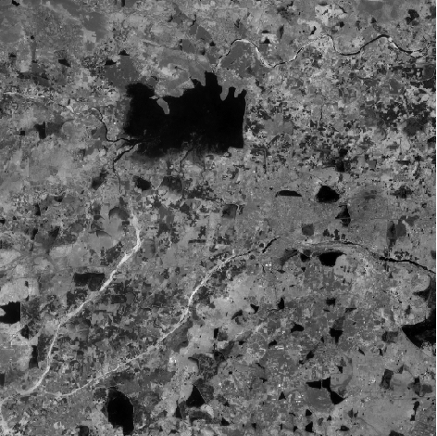
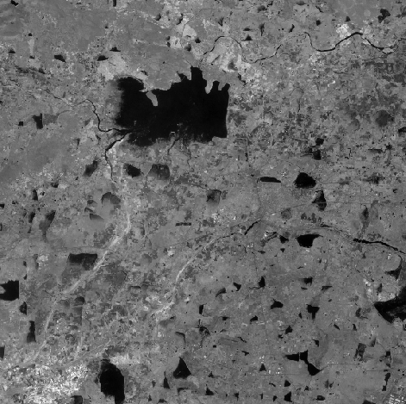
Layer Stacking

Slide 16
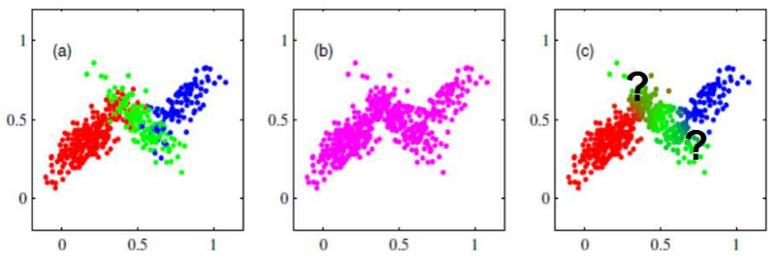
Issues with k-means clustering
Data point is deterministically assigned to one and only one cluster, but in reality there may be overlapping between the cluster

Slide 17
Gaussian mixture model(GMM)
To address the overlapping problems gaussian mixture model was introduced.
each cluster is described by its centroid , covariance , and the size of the cluster(Weight).
Here rather than identifying clusters by “nearest” centroids, fit a set of k gaussians to the data.
estimate gaussian distribution parameters such as mean and Variance for each cluster and weight of a cluster.
After learning the parameters for each data point we can calculate the probabilities of it belonging to each of the clusters.

Slide 18
Fuzzy c-means clustering(FcM)
Fuzzy C-Means algorithm also solves the overlapping cluster problem.
Assign membership to each data point corresponding to each cluster center on the basis of distance between the cluster center and the data point.
More the data is near to the cluster center more is its membership towards the particular cluster center.
Clearly, summation of membership of each data point should be equal to one.
ADVANTAGES:
Unlike k-means where data point must exclusively belong to one cluster center here data point is assigned membership to each cluster center as a result of which data point may belong to more then one cluster center.(

Slide 19
Steps for fuzzy C-means clustering
1. Assign an initial random centroid to each cluster (Group).
2. Compute the distance between each point and the cluster centre using a simple algorithm.
3. Based on distance between each point and the cluster centre, re-compute the membership function.
4. Based on the new membership function, re-compute the centroid.
5. If the difference between the original centroid and the next one is below a certain threshold value say, €, then the algorithm stops, else it continues till this condition is true

Slide 20


Spectral feature exraction
NDVI-Normalized Difference Vegetation Index
NDWI-Normalized Difference Water Index
NDBI-Normalized Difference Builtup Index
NDBI = (SWIR – NIR)/(SWIR + NIR)

Slide 21
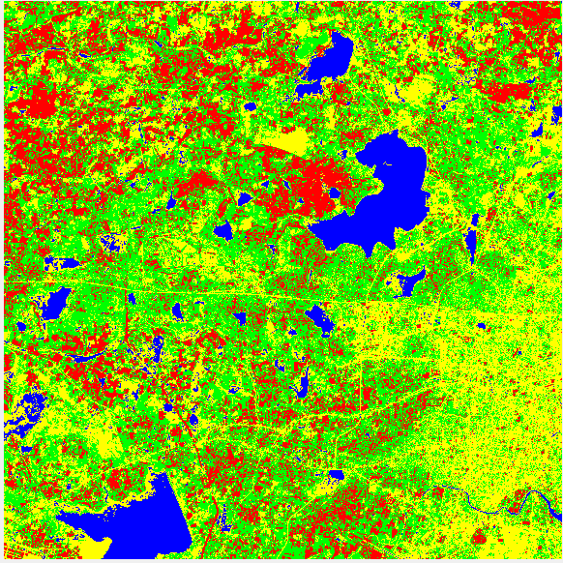
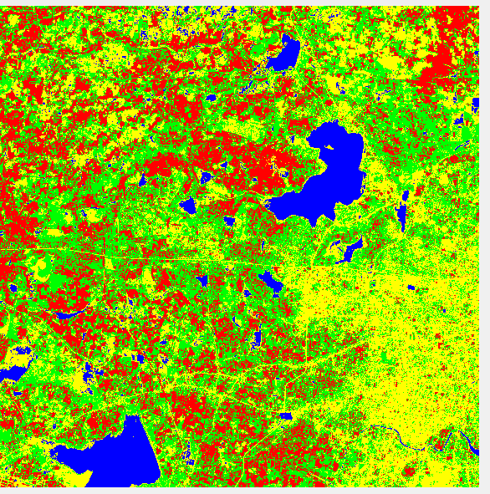
Clustering output for FCM
18 MARCH 2012
13 MARCH 2013
Built-Up
Water
Vegetation
Sparse Vegetation

Slide 22
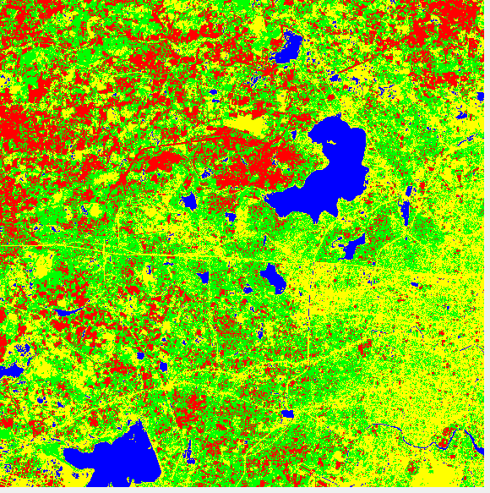
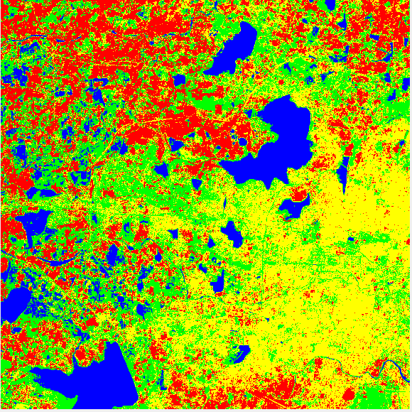
01 APRIL 2014
02 FEBRUARY 2016
Built-Up
Water
Vegetation
Sparse Vegetation

Slide 23
Comparision between gmm and fcm
 | CLUSTER 1 Intra-cluster Distance | CLUSTER 2 Intra-Cluster Distance | CLUSTER 3 Intra-Cluster Distance | CLUSTER 4 Intra-Cluster Distance | TOTAL DISTANCE
GMM | 45.93 | 25.81 | 21.90 | 23.08 | 116.9
FCM | 26.94 | 22.02 | 24.48 | 23.28 | 95.88

Slide 24

Land cover and land use change analysis
PERCENTAGE CHANGE OF LULC
 | Sparse Vegetation | Built-Up | Vegetation | Water
2012 | 31.61 | 20.28 | 40.54 | 7.57
2013 | 21.64 | 33.25 | 40.34 | 4.77
2014 | 24.16 | 28.26 | 43.39 | 4.19
2016 | 23.95 | 32.38 | 32.12 | 11.56
C- No of pixels in a cluster
T-Total no of pixels

Slide 25

Rate of Change in LULC
 | Sparse vegetation | Built-UP | Vegetation | Water
From 2012 to 2013 | -31.56 | 63.94 | -4.6 | -37.1
From 2013 to 2014 | 11.64 | -14.98 | 7.52 | -11.99
From 2014 to 2016 | -8.1 | 14.56 | -25.97 | 17.55
X-Current Year
Y-Previous Year

Slide 26
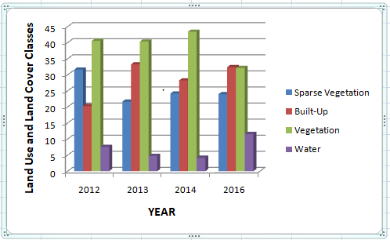

Slide 27
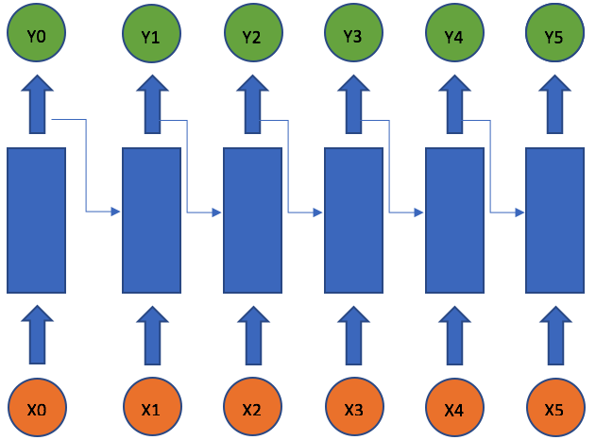
Prediction using LSTM in rnn
The Recurrent Neural Network is a special network, which has recurrent connections so that the network is able to refer to last states and can therefore process arbitrary sequences of input.
All the inputs belonging to a particular sequence or time series are considered independent to each other and are associated with different parameters present in the network.

Slide 28
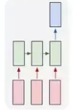
LSTM
MANY TO ONE ARCHITECTURE
Long Short-Term Memory (LSTM) networks are an extension for recurrent neural networks, which basically extends their memory.
LSTM’s enable RNN’s to remember their inputs over a long period of time.
So it is very useful for time series forecasting where we have to analyse each time step.
Flexiblity to use several combinations of seq2seq LSTM models to forecast time-series
*many to one model(useful when we want to predict at the current timestep given all the previous inputs)
*many to many
*one to many

Slide 29
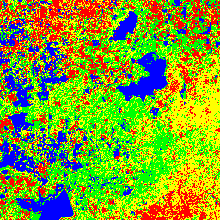
Prediction Output

Slide 30
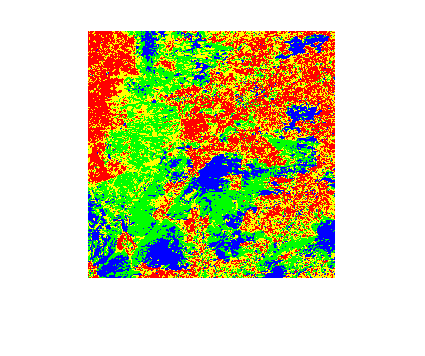
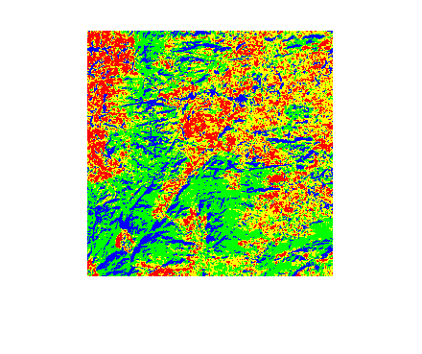
ACCURACY ASSESSMENT
Predicted image for region 2
Ground truth image
Accuracy of prediction for LSTM when compared with ground truth is 78.6%

Slide 31
references
1. Wenzhi Zhao, Shihong Du, and William J. Emery, Fellow, “Object-Based Convolutional Neural Network for High-Resolution Imagery Classification” (2017)
2. Ce Zhang, Isabel Sergeant, Xin Pan, “An object-based convolutional neural network (OCNN) for urban land use classification” (2018)
3. Fotso Kamga Guy , Tallha Akram, “A deep heterogeneous feature fusion approach for automatic land-use classification”(2017)
4. Nataliia Kussul , Mykola Lavreniuk, Sergii Skakun, “Deep Learning Classification of Land Cover and Crop Types Using Remote Sensing Data”(2018)
5. Grant J. Scott, “Training Deep Convolutional Neural Networks for Land–Cover Classification of High-Resolution Imagery “(2017)
6. Atharva Sharma,“Land cover classification from multi-temporal, multi-spectral remotely sensed imagery using patch-based recurrent neural networks”(2018)

Slide 32

Thank You

